Slide 1
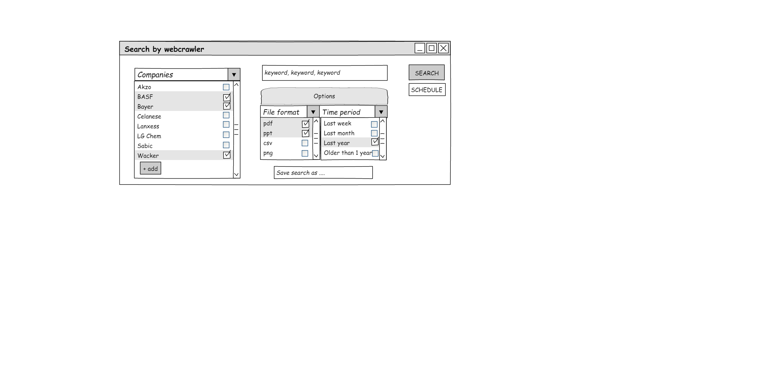

Webcrawler allows an intuitive search

Slide 2
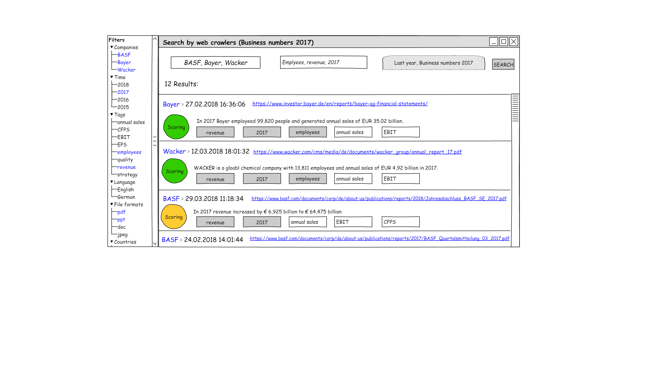
Search results are clearly presented

Slide 3
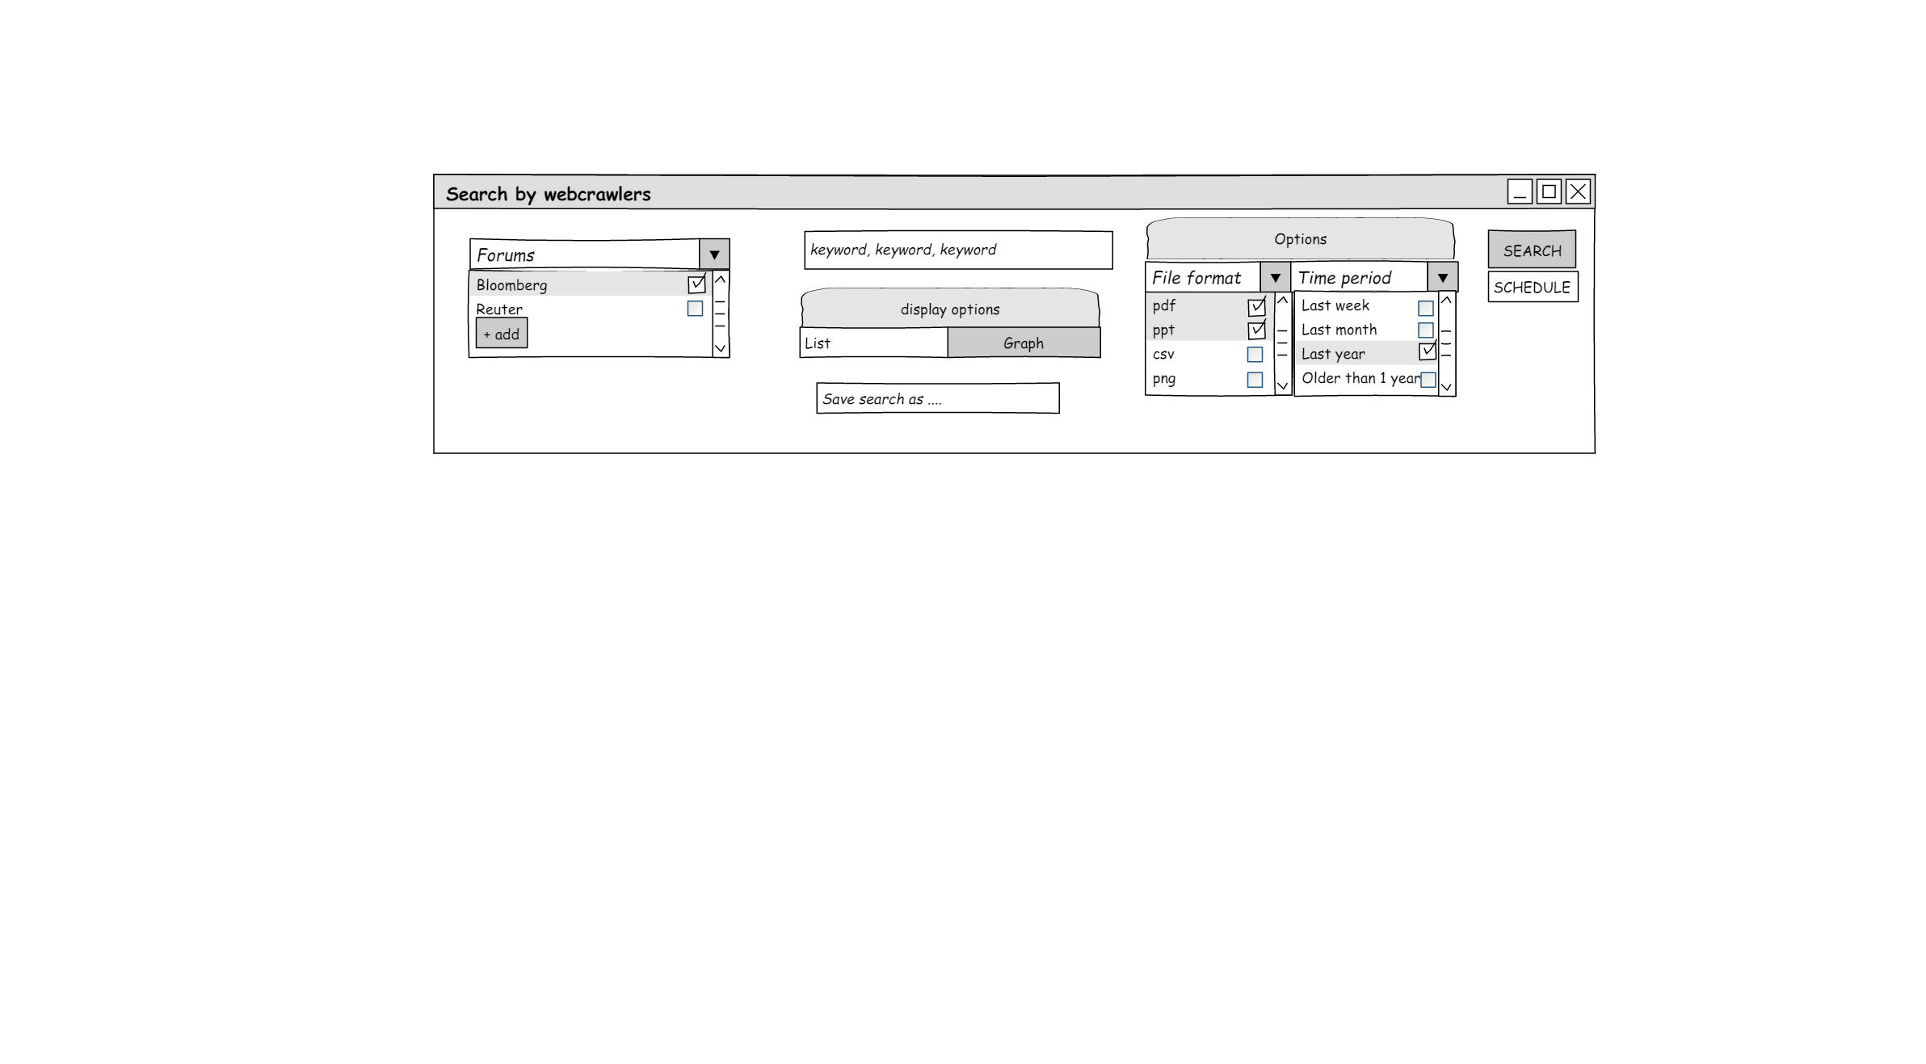
Searching in Portals can also be realized

Slide 4
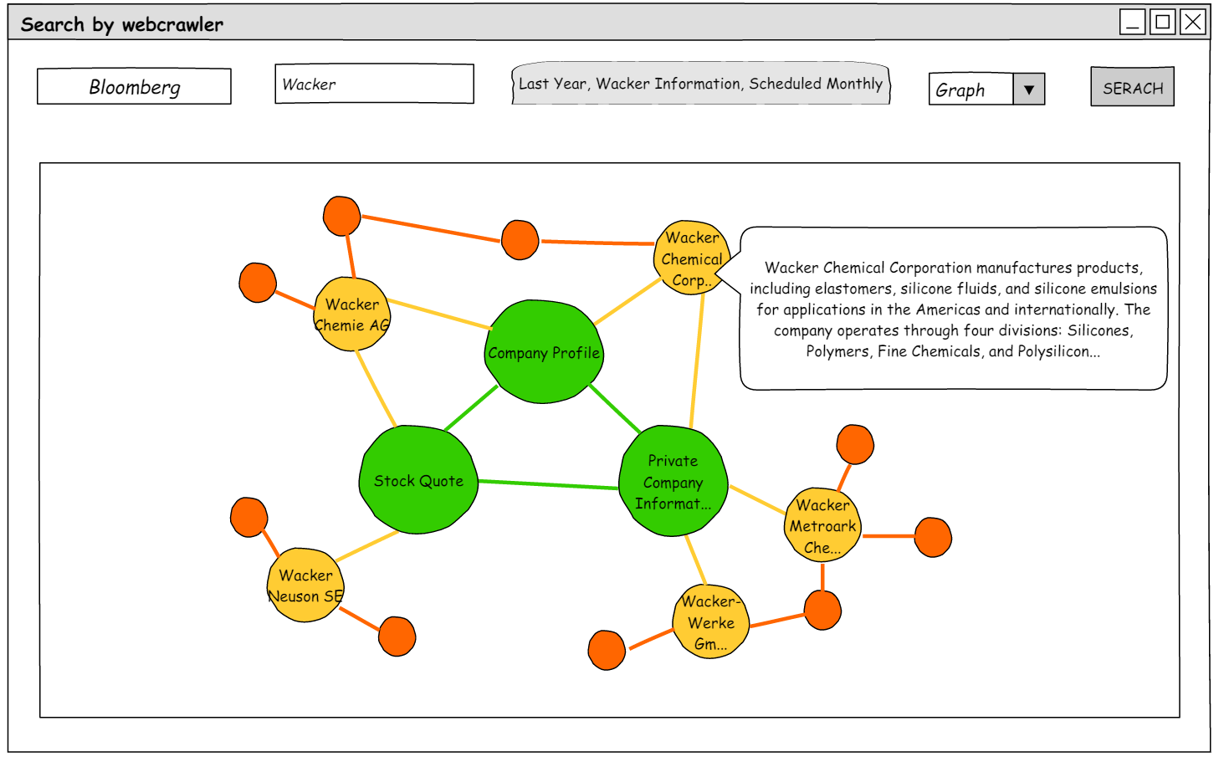
Interactive Representation make searc results tangible

Slide 5
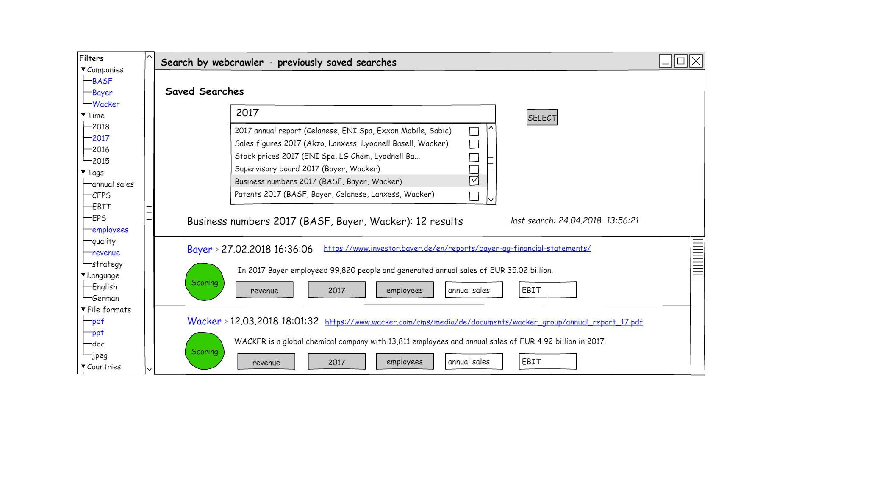
Previsously perfomed searches are Always Available

Slide 6
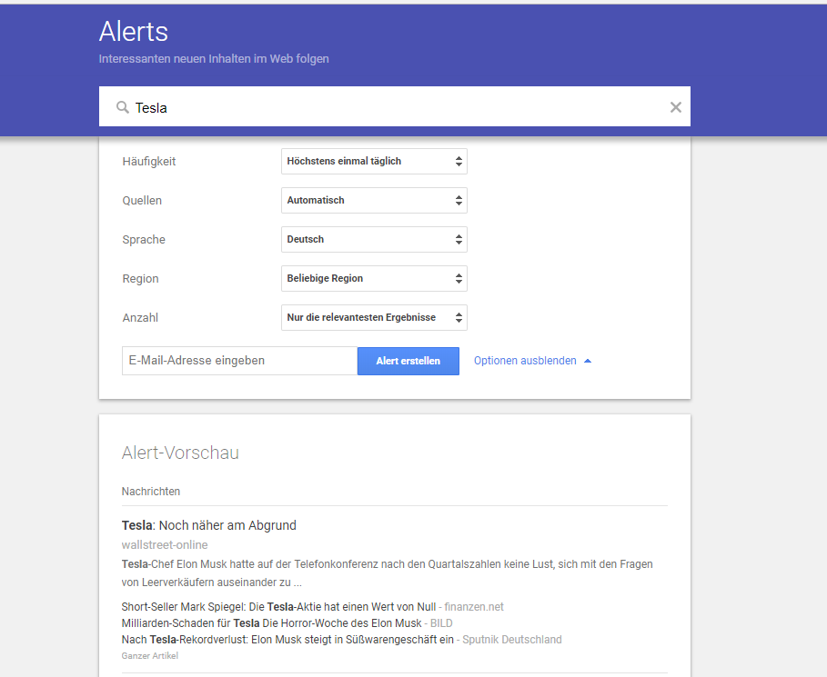
Google Alerts shows the relevant elements from around the world
Get email updates of the latest relevant Google results (Web, news, etc.) based on your queries.

Slide 7
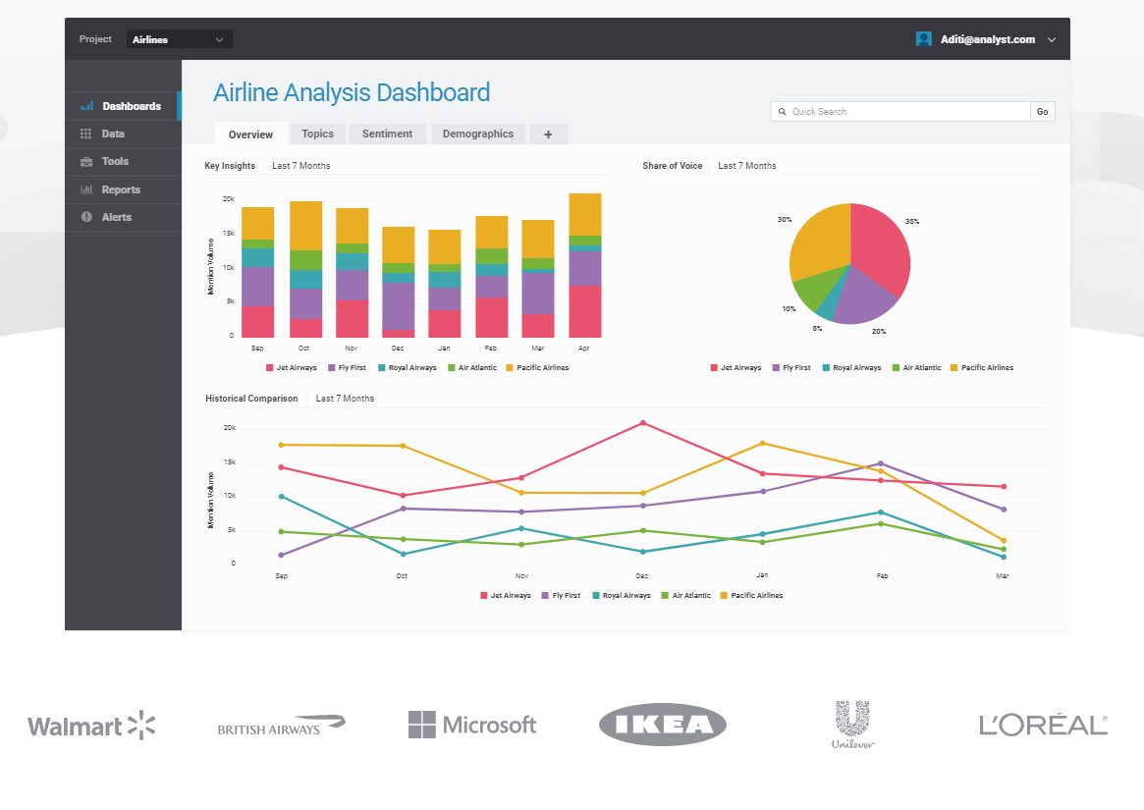
Brandwatch refelcts the customer opinions
This service reads through and summarizes what’s being said on the Web about brands, people and products. Define keywords to track (brands, topics, people names, products) and get access to mentions, trend and campaign analysis and competitive info.

Slide 8
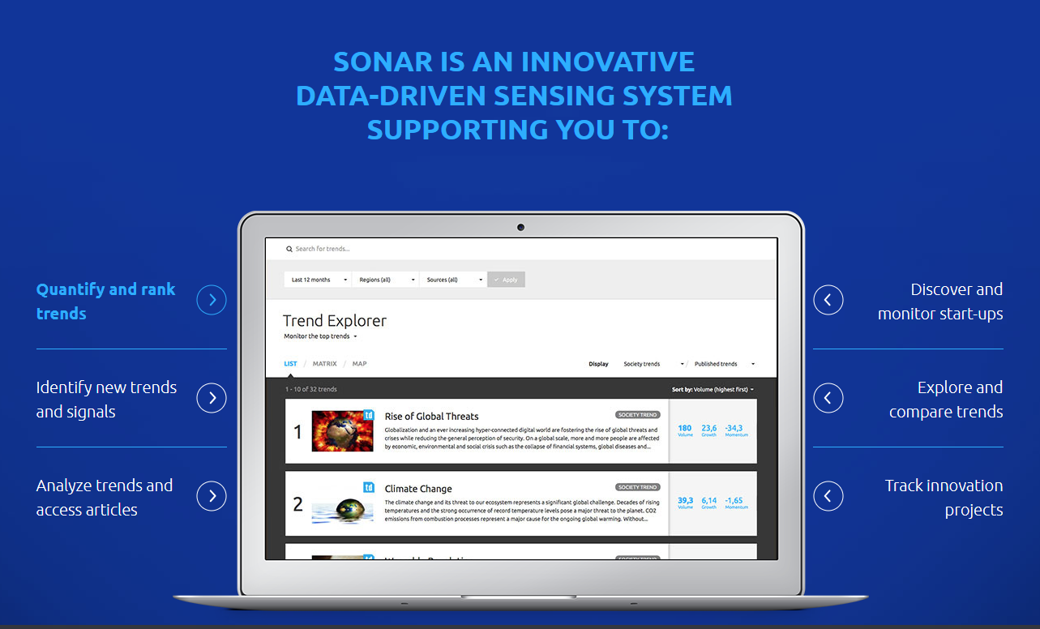
Sonar Trend reflects the current trendS
Sonar trend visualization reveals topics, people and emotions affecting your business right now. Identify, anticipate and instigate trends that are driving perceptions of your brand and business.

Slide 9











Architecture
Hadoop
Preprocessing
Web Crawler
DB mit
Volltextsuche
HDFS
Text Analytics
F r o n t E n d

Slide 10
Toolevaluation – Long List Front End
Javascript:
Bootstrap – basic features, but difficult for advanced usecases
React – powerful library for webapps
Angular – with Angular 2+ it is competitive again react
Vue - simple but lightwight framework
Ember – ancient and difficult framework
Androids/iOS-Apps – good choice for moibile apps
Native
Java(Swing) – a jvm is needed
.NET – just for windows apps

Slide 11
Toolevaluation – Long List Full Text Search
Apache Solr - A widely used enterprise search engine based on Apache Lucene
BaseX - Light-weight Native XML DBMS with support for XQuery 3.0 and interactive GUI.
Google Search Appliance - The Google Search Appliance consists of hardware and software for indexing documents in local networks.
Elasticsearch - A distributed, RESTful modern search and analytics engine based on Apache Lucene info
Lucene - is a free and open-source information retrieval software library but no databse included
MarkLogic - Operational and transactional Enterprise NoSQL database
PostgreSQL - Widely used open source RDBMS
Microsoft Azure Search - Search-as-a-service for web and mobile app development
Sphinx - Open source search engine for searching in data from different sources, e.g. relational database
Splunk - Analytics Platform for Big Data
Xapian - is a free and open source probabilistic information retrieval library, released under the GNU General Public License. It is a full text search engine library for programmers.

Slide 12
Toolevaluation – Long List Preprocessing
Jsoup - jsoup is a Java library for working with real-world HTML for extracting and manipulating data, using the best of DOM, CSS, and jquery-like methods.
Apache Tika- is a content analysis tool which can be used to extracts metadata and text content from various documents.
Boilerpipe - is a Java library. It is based on Boilerplate Detection using Shallow Text Features.
Pdfbox - is an open source pure-Java library that can be used to create, render, print, split, merge, alter, verify and extract text and meta-data of PDF files.

Slide 13
Toolevaluation – Long List Text Mining
IBM Watson – powerful in total, many services to provide full usability
Spark NLP/NLTK – huge lib – easy to develop in Python
Aika – extract semantic information out of text
Carrot2 – good tool for cluster serach
GATE – Java based, (tokenizer, gazetteer, sentence splitter, named-entity recog., coreference tagger)
HP Autonomy – text mining, categorization & clustering
WordStat – content&sentiment analysis – mainly used for BI & analysis of web sites
NetOwl – entities, sentiment anal., geotagging, name translation&matching, identity resolution
Lexalytics – text analytics for soc. Media monitoring, customer service analysis
SAP Hana – platform provides search, text anal. (entity, relations), TM functionality

Slide 14
Toolevaluation – Long List Web Crawler
Apache Nutch – highly scalable & feature rich, can be biased to fetch selected pages first
Scrapy – easy to set up, not as scalable as Nutch or Heritrix
Heritrix – specialised for 1:1 copies – easy set up
WebSphinx – multithreaded web page retrieval
JSPider – downloads complete web sites, check for errors, analysis structure
GNUWGet – mirror directories, supports http proxies&cookies
WIRE – scalable, highly configurable (crwaling, indexing, scheduling)
Pavuk – can be used as full features FTP mirroring tool
Tekeport – java script parsing (capablity for better compley sites), scheduler
Web2sidk – easy to use, fixes downloaded websites for easy offline browsing
Octoparse – provides scheduled extraction and storing in structured data
Visual Scarper – point-click interface, allows scheduled scraping
Scraoerjs – still frequently used, but outdated

